Slide 1
7X24 Meeting Atlanta Chapter October 2, 2014 Karen Hays Policy Manager, Air Protection Branch Georgia Environmental Protection Division

Slide 2
What I Will Talk About
The Air Protection Branch
Some background on the National Ambient Air Quality Standards
Georgia Rule 391-3-1-.02(2)(mmm)
Changes to Georgia Rule 391-3-1-.02(2)(mmm) to address needs of data centers
How is the air quality in Georgia?
Other issues
Notes:
Tan shading indicates current nonattainment areas, however we are now in compliance with those standards and are working to get them designated back to attainment.
Green shading indicates standards whose reviews were recently completed.
Yellow shading indicates standard whose review in the proposal stage.
Blue shading indicates standard whose review is projected to be proposed soon.

Slide 3
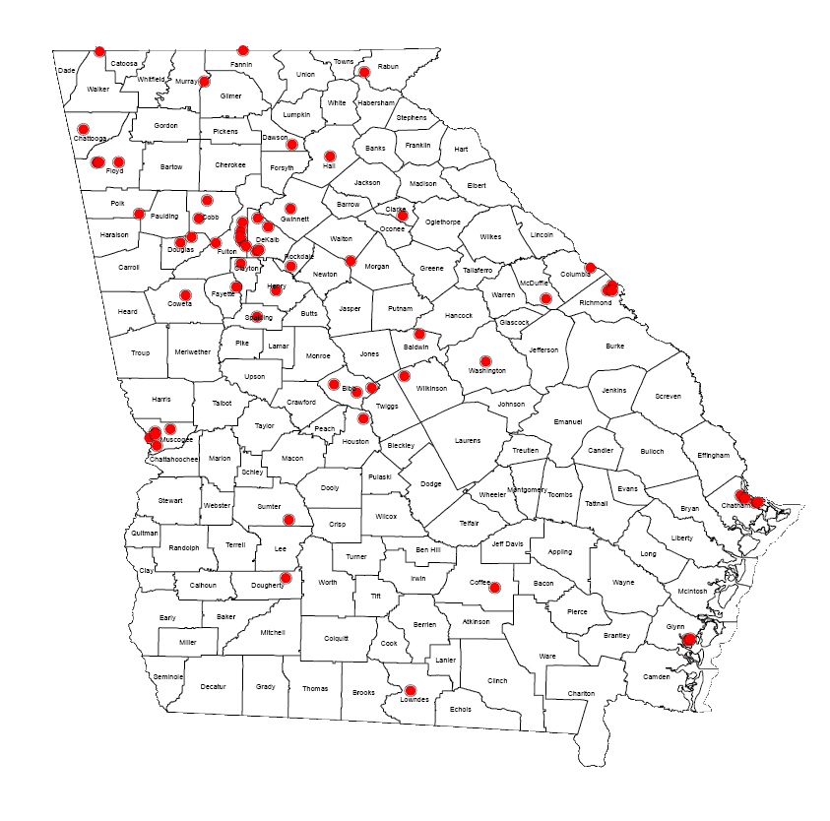
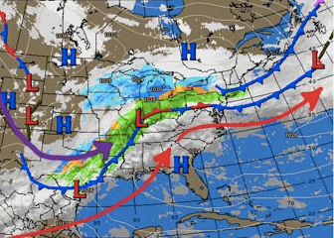
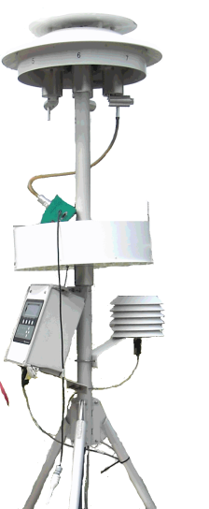
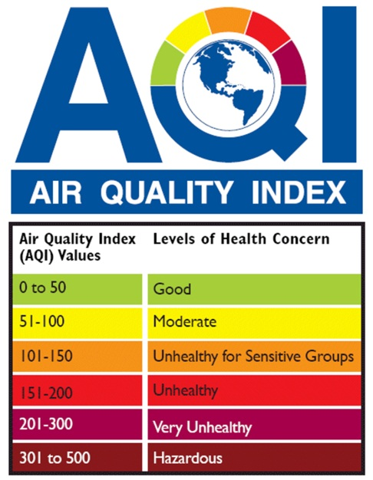
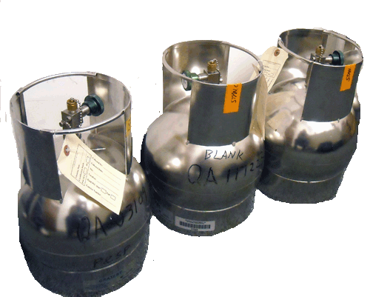
Monitor and Report Air Quality
Ambient Monitoring Program
Meteorological Monitoring
53 Monitoring sites in Georgia
Monitor, Collect, Verify and Analyze Multiple Pollutants
Air Quality Forecasting

Slide 4
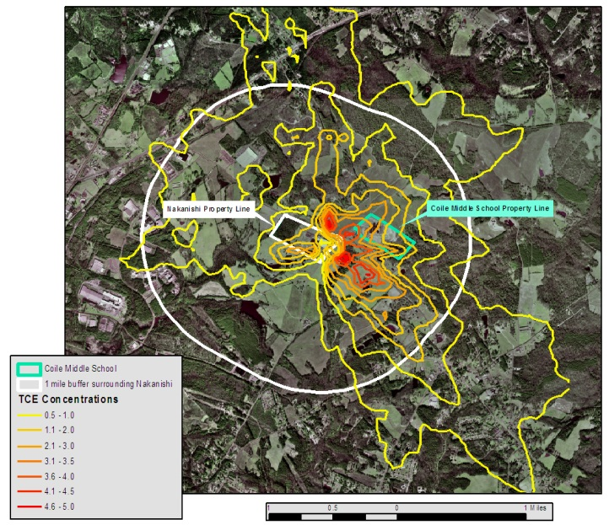
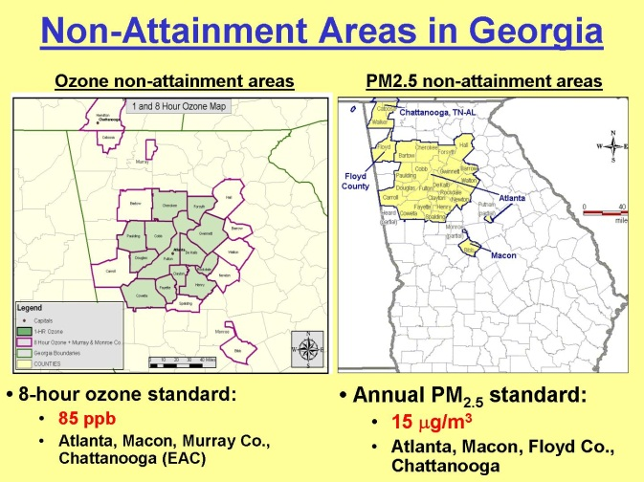
Data Analysis and Planning
Managing Air Quality
Planning and Support Program
Data Analysis
Modeling
Control Strategy
Rule Development
Manage Georgia’s State Implementation Plan (SIP)

Slide 5
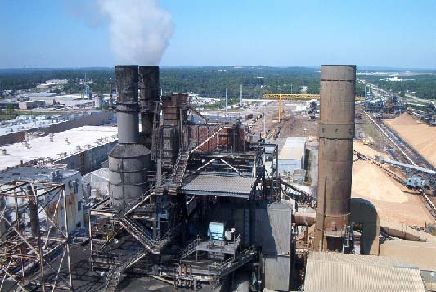
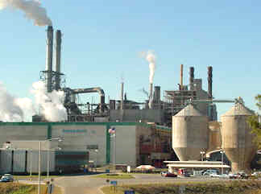
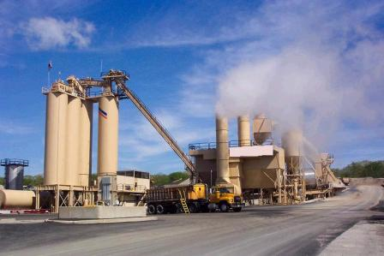
Permitting
Stationary Source Permitting Program
Implements all air quality related permitting requirements including New Source Review and Operating Permits
Rule applicability analysis (federal and state)
Toxic Impact Assessment
Develop monitoring, record keeping and reporting requirements
Review applications and issue air quality construction and operating permits for industries in Georgia.
EPD currently holds permits for 3500 facilities in Georgia
400 are Title V Facilities

Slide 6
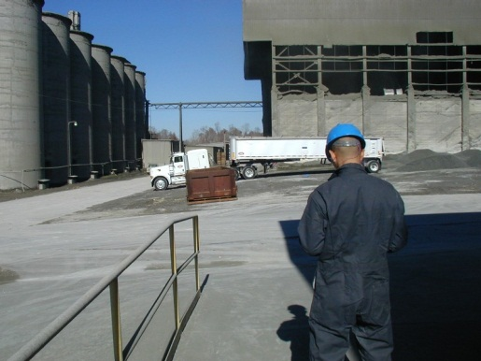
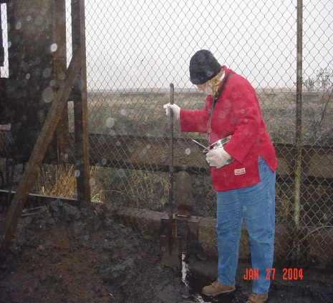
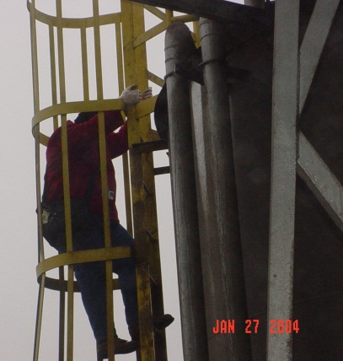
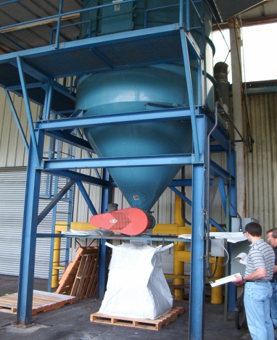
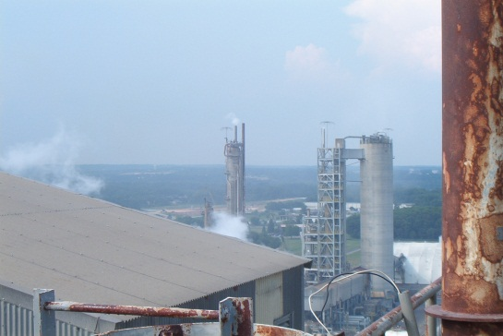
Compliance Assurance
Stationary Source Compliance Program
Evaluate stationary sources for compliance with state and federal environmental regulations.
On-site inspections
Review reports, stack test results and risk management plans
Take appropriate enforcement action for non-compliance
Permitting and compliance assistance for small businesses

Slide 7
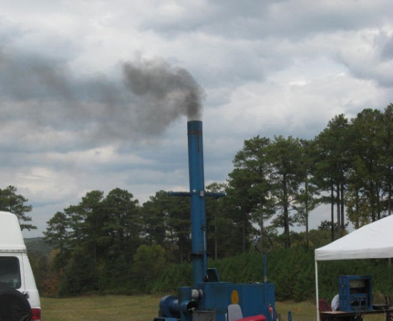
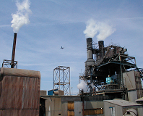
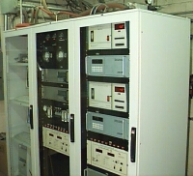
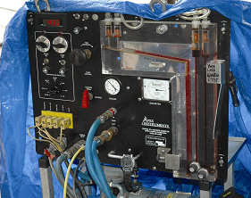
Compliance Assurance
Industrial Source Monitoring Program
Specifies monitoring and testing procedures
Conducts emission monitor and stack test audits
Reviews and approves final reports for stationary sources
Conducts "smoke school" for affected industry personnel

Slide 8
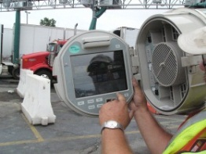
Reducing Emissions from Mobile Sources
Reduce Mobile Emissions
Mobile and Area Sources Program
~3 million automobiles tested each year
Oversee enforcement for 900+ vehicle emission testing stations
Issue grants for school buses and truck stops to reduce diesel emissions
Regulate recovery of gasoline vapors at over 4,000 gasoline stations statewide
Public outreach and education
Control and regulate on and off-road mobile emissions through regulatory and voluntary measures.

Slide 9
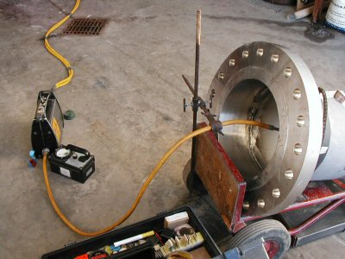
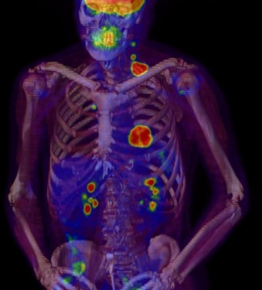
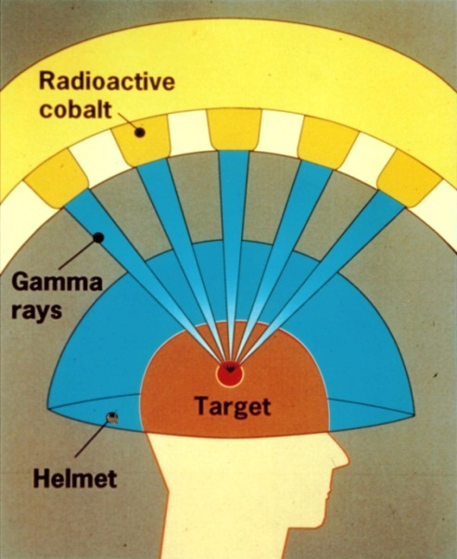
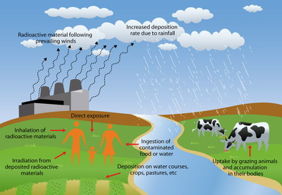
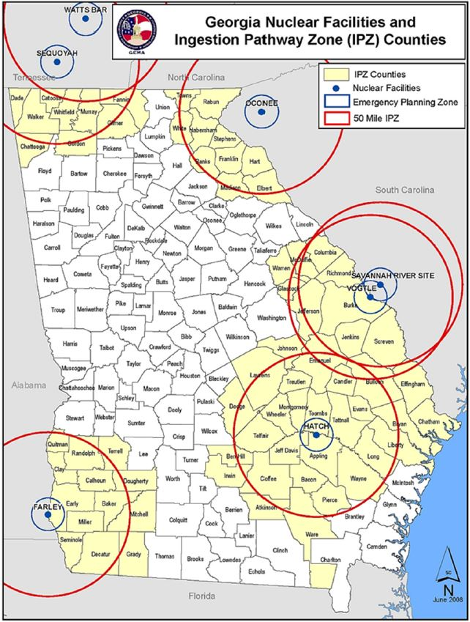
Radiation Program
Monitor Radioactive Materials
RADIOACTIVE MATERIALS ENVIRONMENTAL RADIATION

Slide 10
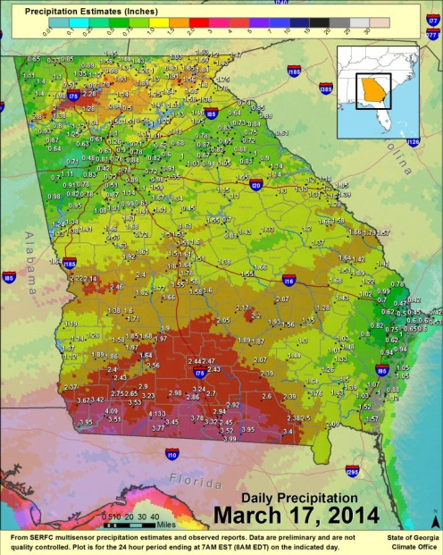
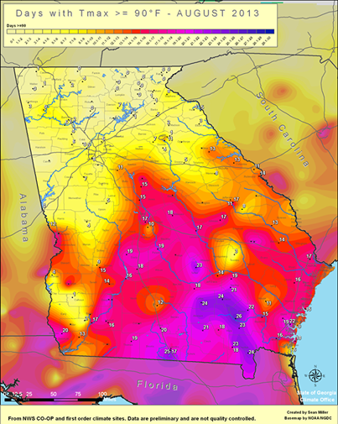
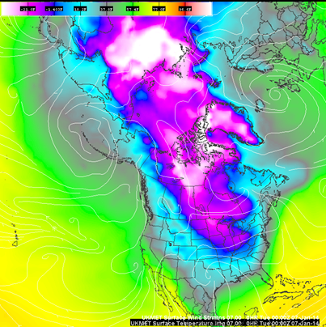
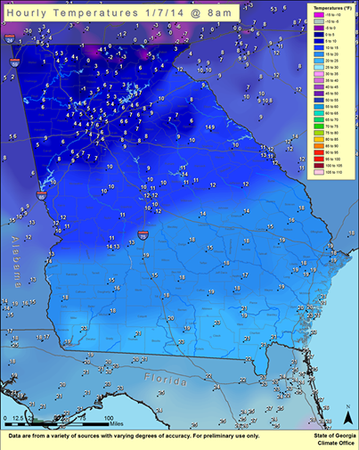
Monitor Climate Change
State Climate Office
Collect, disseminate, and interpret climate data for the State of Georgia
Issuing daily air quality forecasts for Georgia’s major cities

Slide 11
National Ambient Air Quality Standards
The Clean Air Act requires EPA to set National Ambient Air Quality Standards (NAAQS) for pollutants considered harmful to public health and the environment
EPA set NAAQS for six "criteria" pollutants:
Carbon Monoxide
Ozone
Nitrogen Oxides (NOx)
Sulfur Dioxide (SO2)
Particulate Matter (PM)
Lead
EPA is required to review each NAAQS every five years, and revise them if necessary
States are required to develop plans to improve air quality in “nonattainment” areas, areas not meeting NAAQS
Notes:
Tan shading indicates current nonattainment areas, however we are now in compliance with those standards and are working to get them designated back to attainment.
Green shading indicates standards whose reviews were recently completed.
Yellow shading indicates standard whose review in the proposal stage.
Blue shading indicates standard whose review is projected to be proposed soon.

Slide 12
Current National Ambient Air Quality Standards
Notes:
Tan shading indicates current nonattainment areas, however we are now in compliance with those standards and are working to get them designated back to attainment.
Green shading indicates standards whose reviews were recently completed.
Yellow shading indicates standard whose review in the proposal stage.
Blue shading indicates standard whose review is projected to be proposed soon.

Slide 13
NAAQS – Update
Brief History of Georgia Rule 391-3-1-.02(2)(mmm)
NOX Emissions from Stationary Gas Turbines and Stationary Engines used to Generate Electricity
Rule (mmm) was adopted by the DNR Board and submitted to EPA as part of a 1999 attainment plan for the 1-hour ozone NAAQS (1979 standard)
Rule (mmm) was implemented to reduce emissions from “peaking engines”
Notes:
Tan shading indicates current nonattainment areas, however we are now in compliance with those standards and are working to get them designated back to attainment.
Green shading indicates standards whose reviews were recently completed.
Yellow shading indicates standard whose review in the proposal stage.
Blue shading indicates standard whose review is projected to be proposed soon.

Slide 14
Georgia Rule 391-3-1-.02(2)(mmm)
Rule (mmm) limits nitrogen oxide (NOx) emissions from any stationary gas turbine or any stationary engine used to generate electricity whose nameplate capacity is greater than or equal to 100 kilowatts and is less than or equal to 25 megawatts
Nitrogen oxide emission limits that apply depend on the date the engine was installed or modified
Nitrogen oxide emission limits for Rule (mmm) only apply May 1 through Sept 30 in the 45 counties surrounding Atlanta

Slide 15
Rule (mmm) emission limit exemptions
“Emergency standby stationary gas turbines and stationary engines” defined as any stationary gas turbine or stationary engine that operates only when electric power from the local utility is not available and which operates less than 200 hours per year
This means that generators at data centers were required to operate in accordance with the definition of emergency standby stationary engines or install controls

Slide 16
Redesignation 1997 Ozone NAAQS
Redesignation 1997 Ozone NAAQS
The redesignation of the Atlanta Metro Area to attainment for the 1997 ozone NAAQS in December 2013 allowed GA EPD to move forward with some rule changes that were negatively impacted business
NOTE: Atlanta is still nonattainment for the 2008 ozone standard
Georgia Rule (mmm) was having a negative impact on data centers located in around the Atlanta Metropolitan Area
Notes:
Discuss Director’s Office review of these documents prior to public notice.

Slide 17
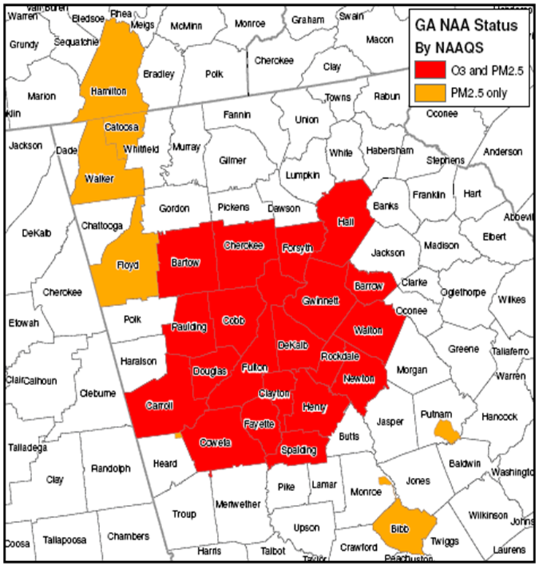
Redesignation 1997 Ozone NAAQS
Redesignation Request
Atlanta Ozone submitted to EPA 4/4/12
Proposed Approval in FR 2/4/13
Final Approval in FR 12/2/2013
1997 Ozone standard was 0.080 ppm (8-hour standard)
Notes:
Discuss Director’s Office review of these documents prior to public notice.

Slide 18
The Problem
Units at data centers have unique operational needs:
During a power outage, a data center will receive power from an uninterruptable power supply and not the generators, as envisioned by the definition of emergency standby engines
Generators need to operate when the UPS fail or become unreliable
Generators at data centers are operated for routine testing and maintenance

Slide 19
Rule (mmm) Change for Data Centers
On March 25, 2014, the Georgia Board of Natural Resources (DNR Board) adopted revisions to Georgia Rule 391-3-1-.02(2)(mmm), “NO_{X} Emissions from Stationary Gas Turbines and Stationary Engines used to Generate Electricity” that added subparagraph 8 pertaining to stationary engines at data centers
The Rule change became effective 5/4/2014
EPA is requiring a 110(l) analysis as part of the State Implementation Plan revision. GA EPD is preparing that submittal now.

Slide 20
Rule (mmm) Changes for Data Centers
Stationary engines at data centers that meet all of the following criteria are not subject to the Rule (mmm) emission limitations:
Operate only for routine testing and maintenance, when electric power from the local utility is not available, or during internal system failures
Total annual operation for the engine is less than 500 hours per year

Slide 21
Rule (mmm) changes for Data Centers
(continued):
Operation for routine testing and maintenance during the months of May through September occurs only between 10 p.m. to 4 a.m. Operation for routine testing and maintenance during the months of January through April and October through December may be done during any time of day
The facility maintains records of all operation, including the reason for the operation

Slide 22
What Do You Need to Do?
Some data centers may require a modification to their permit
Check your Permit
Submit a permit amendment request to update your Rule (mmm) requirements if necessary
Contact Eric Cornwell, Manager, Stationary Source Permitting Program, if you have any questions

Slide 23
Statewide Ozone Violation Days
Violations are through 8/24/14. Data is
validated through May 2014.

Slide 24
Ozone – 3-Year Design Value
1997 NAAQS (0.084 ppm)
2008 NAAQS (0.075 ppm)
EPA Final Policy Assessment
0.060 to 0.070 ppm

Slide 25
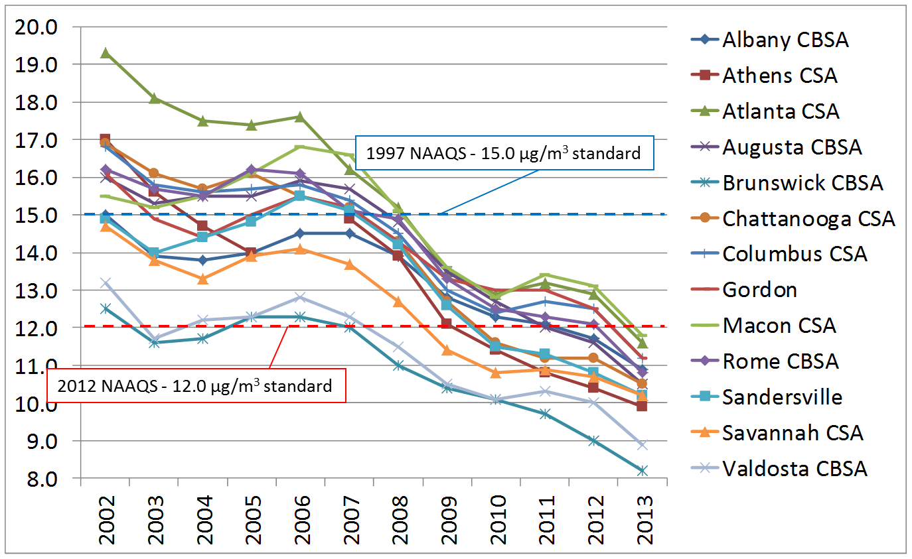
PM_{2.5} Annual Design Values (µg/m³)

Slide 26
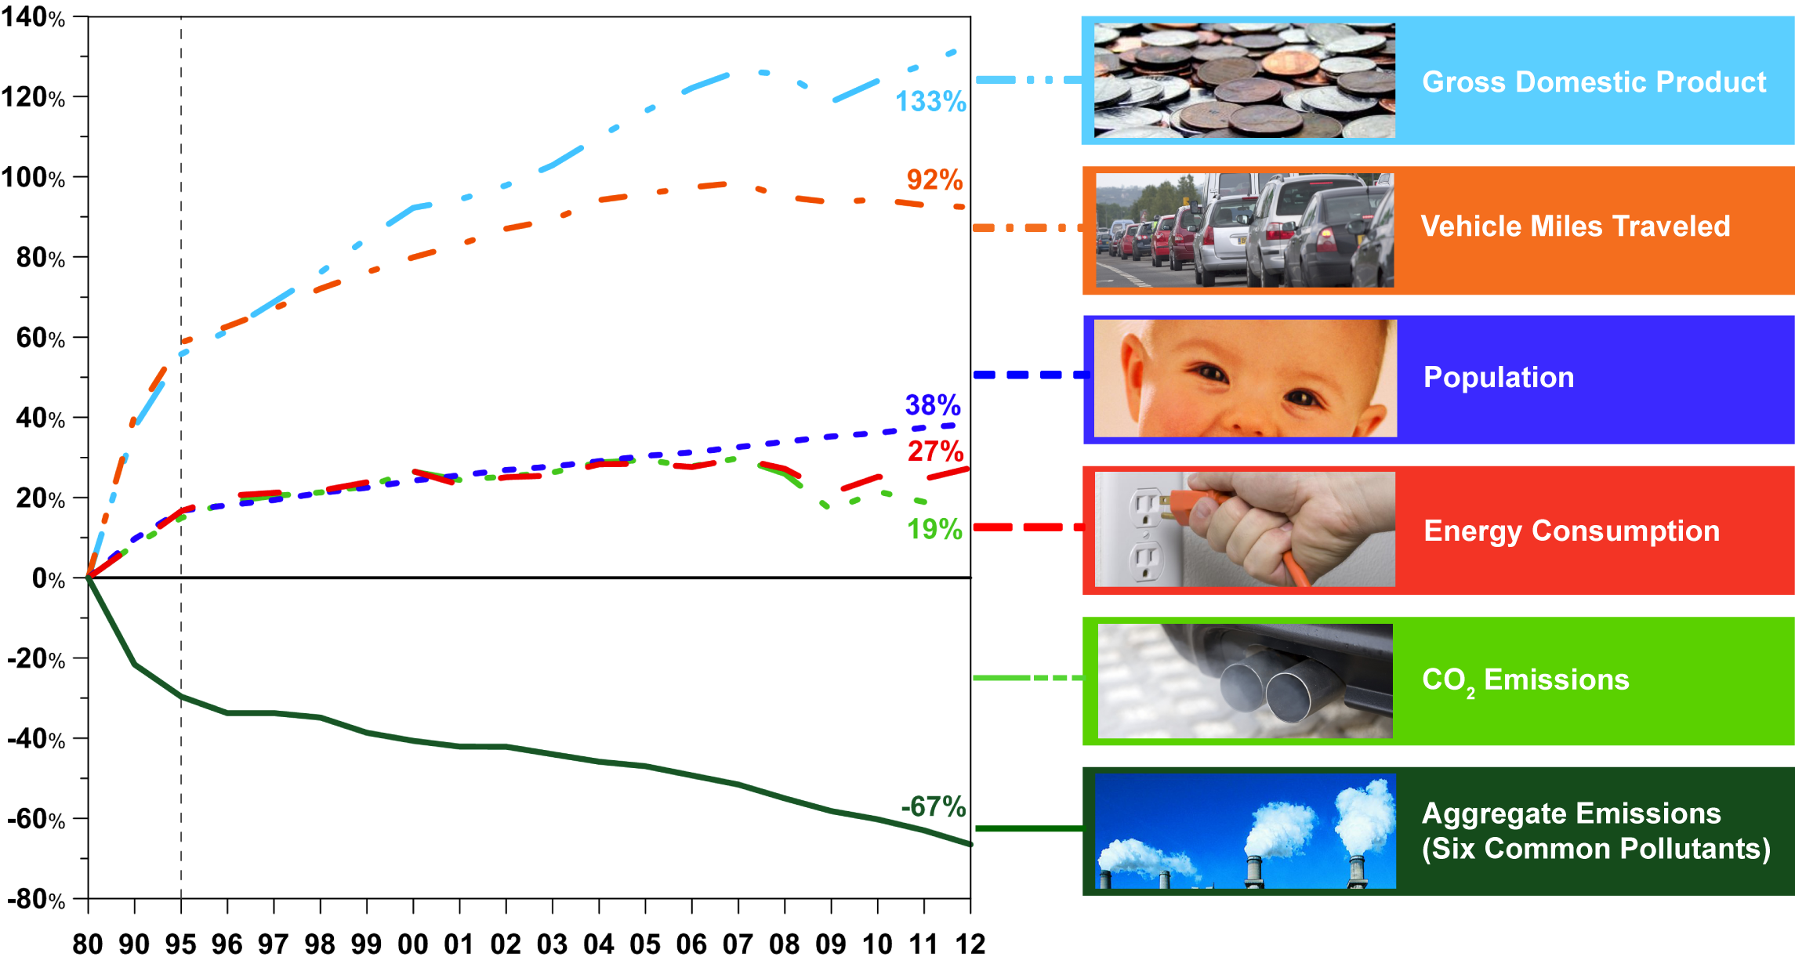
Economic Growth & Cleaner Air Are Compatible
Between 1980 and 2012, total emissions of the six principal air pollutants dropped by 67 percent, while the gross domestic product increased by 133 percent.

Slide 27
Issues to Keep an Eye On
New Ozone Standard, expected to be lower than current standard, proposed December 2014
EPA’s Clean Power Plan Proposal

