Slide 1
EPA Tier 4 Certified Generator Sets

Slide 2
Agenda
Tier4 Regulations
  Implications
  FAQ
Tier4 Solution
  Product Architecture

Slide 3
EPA (NSPS) for Stationary CI Engines, Part 60, Subpart IIII
60.4219 What definitions apply to this subpart?
Emergency stationary internal combustion engine means any stationary
internal combustion engine where operation is limited to emergency situations and required testing and maintenance. Examples include stationary ICE used to produce power for critical networks or equipment (including power supplied to portions of a facility) when electric power from the local utility (or the normal power source, if the facility runs on its own power production) is interrupted,
or stationary ICE used to pump water in the case of fire or flood, etc.
Stationary CI ICE used to supply power to an electric grid or that supply power as part of a financial arrangement with another entity are not considered to be emergency engines.
http://www.epa.gov/ttn/oarpg/new.html

Slide 4
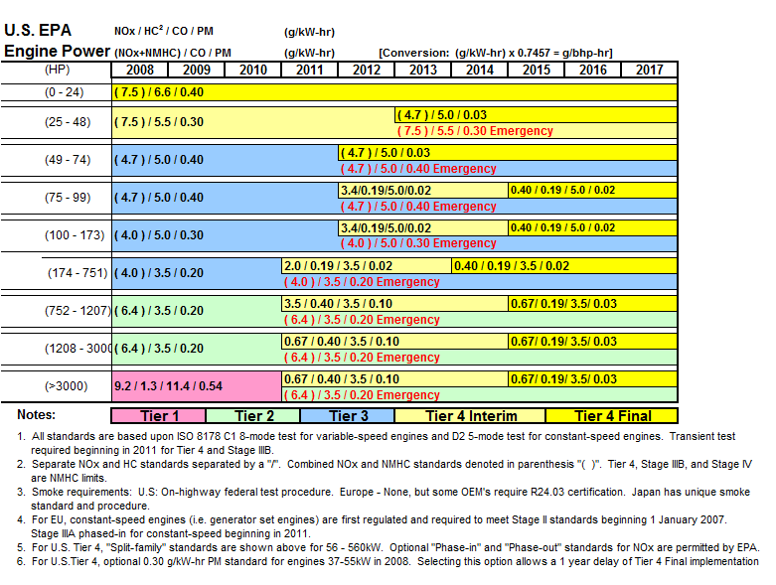
CI NSPS Stationary Emissions - Diesel engines

Slide 5
EPA NSPS allowed Emissions
Product built Jan 2011 or newer
  Exhaust Constituent T4i (2011) T4F (2015) Loco
  (g/kw-hr) (g/kw-hr) (g/kw-hr)
  Nitric Oxides (NOx) 0.67 .067 1.7
  Hydrocarbons (HC) 0.40 0.19 .19
  Carbon Monoxide (CO) 3.50 3.50 2.0
  Particulate Matter (PM) 0.10 0.03 .04

Slide 6
ENVIRONMENTAL PROTECTION AGENCY
FEDERAL LAW APPLIES TO ALL US STATES AND TERRITORIES
40 CFR Part 63
[EPA-HQ-OAR-2008-0708, FRL-9756-4]
RIN 2060-AQ58
Stationary Emergency – Demand Response (pub 1/14/2013)
  Determined by the Reliability Coordinator issuance of Emergency Alert Level 2 (NERC EEA Level 2)
    EEA Level 2 defined by NERC standard EOP-002-3
    Limited operation up to 100 hours per year
    50 hrs/yr of non-emergency operation allowed to avert interruption of normal power supply.
    Counts against allowable 100 hours
    Lots of record keeping

Slide 7
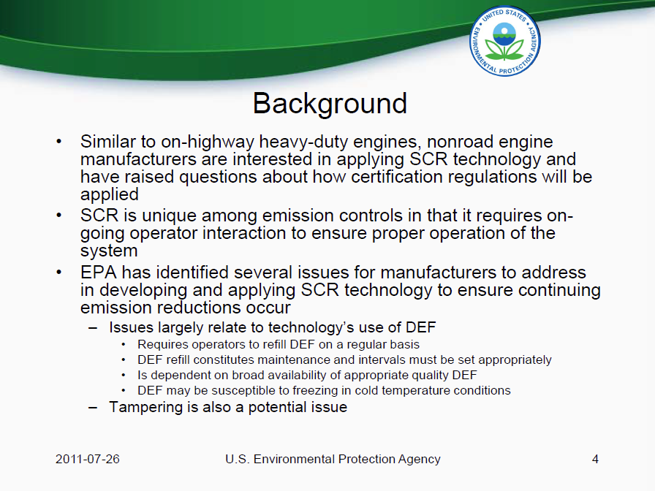
SCR Inducement Background
Source:
http://www.epa.gov/otaq/cert/documents/nrci-scr-web-conf.2011-07-25.pdf

Slide 8
NSPS Emission Standards---Can I buy a T2 and upgrade to T4i/f later?
Short answer is NO.
PART 1068.101
(1) Introduction into commerce. You may not sell, offer for sale, or introduce or deliver into commerce in the United States or import into the United States any new engine/equipment after emission standards take effect for the engine/equipment, unless it is covered by a valid certificate of conformity for its model year and has the required label or tag. You also may not take any of the actions listed in the previous sentence with respect to any equipment containing an engine subject to this part's provisions unless the engine is covered by a valid certificate of conformity for its model year and has the required engine label or tag. We may assess a civil penalty up to $37,500 for each engine or piece of equipment in violation.

Slide 9
NSPS Certified verses compliant
Site certified---????? Fail
Verified ----????? Fail
EPA letter
60.4201 in subpart IIII requires all 2007 model year and
later engines <30 l/cyl displacement to be certified (as in get an EPA
certificate of conformity) to the applicable standards for the engine
model year and power. As we discussed, adding an aftermarket "verified"
technology in the field to a Tier 2 engine is NOT the same as certifying
it to the Tier 4 standards and is not an acceptable substitute for Tier
4 certification. Per 60.4211(c), the engine owner/operator is also on
the hook to comply by purchasing an engine that is certified to the
applicable standard.
"Field verified, compliant capable, verified solutions, Tier 4 capable," These are terms that the EPA does not accommodate, and finds to be prohibitive in the CI RICE Stationary Prime Power World.

Slide 10
Tier 4 Certified - what this means
Certification requires rigorous testing and validation.
  Only 2 Power Gen manufacturers offer solution above 752 hp/500kw.
  5 Mode EPA Test
  Accelerated life test/DF Test Cycle
    14 hrs per day
    1034 hrs
    5 mode test at 0, 250, 500, 750, 1034 hrs
Compliance is a statement
  Read the fine print from aftermarket suppliers
  Typically publish emission limits at rated power condition(not 5 modes of data).

Slide 11
T4i certified verses compliant
Specific design, materials, and construction meeting requirements, periodic review, and approval by EPA.
3rd party agency verified +1000 hour pre-described destructive force testing procedure must be included in EPA certification application.
Individual engine platform certification testing documented and certified by 3rd party agency.
Certification application must include data proving emission compliance through the usable product life at 8000 hours. Must be approved by EPA. CPG product design life is 20,000 hours.
Specific control and alarming functionality addressing all inducement requirements must be approved by EPA.
Mandatory 5 year, 3000 hour comprehensive warranty must be provided by the Manufacturer for all emissions components.

Slide 12
Fumigation
Can I fumigate my T4i certified set?
Implications
EPA Certified solutions are based on ULSD fuel only.
Natural gas fuel injection system provider does not take responsibility for emissions.
Nat gas mixture will reduce Nox but CO and HC increase.
-Engine emissions control system may not be designed to manage variable combustion rates and temperatures.
-Emission control system may need specialized control sensitivity to load profile, and gas infusion rate as fueling levels change.
Risk of creative regeneration activity for competitive systems.
Owner is responsible for emissions compliance.

Slide 13
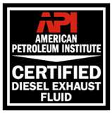
What is Diesel Exhaust Fluid?
Diesel Exhaust Fluid is
  Reactant used in the SCR system
  32.5% urea in 67.5% deionized water
  Non-toxic
  Non-polluting
  Non-flammable
DEF has purity requirements defined by American Petroleum Institute (API)
DEF freezes at 12° F (-11° C)
  Thaws at consistent concentration
  Equipment tanks and lines will be heated
When stored at extreme temperatures DEF remains non-toxic
0
1
0

Slide 14









DEF Available for All Markets Today
On-highway demand has inspired the manufacturing and distribution of DEF in North America
Cummins supports the DEF needs with a broad CF product line
  Bulk (>5000 gal.)
  Plastic and Disposable Totes
  (330 and 275 gal.)
  Drum (55 gal.)
  Dispensing Equipment
Over 40 brands of DEF and growing
From http://www.factsaboutscr.com/def/default.aspx

Slide 15
2015 Tier 4 Final
Prebuys possible
  EPA law does not allow stockpiling
  2014 gen sets require installation by: Dec 31, 2016
Engine serial number and mfg date is critical
  Appx $80k increase in price i to F.

Slide 16
FAQ
§60.4208 What is the deadline for importing or installing stationary CI ICE produced in previous model years?
(f) After December 31, 2016, owners and operators may not install non-emergency stationary CI ICE with a maximum engine power of greater than or equal to 560 KW (750 HP) that do not meet the applicable requirements for 2015 model year non-emergency engines.

Slide 17
Agenda
Background
  What is Tier4
CPG Tier4 Solution
  Product Architecture
  Key Features/Differentiators
  Competitive Landscape
Plays

Slide 18
WHAT is Tier4
Diesel Engine Emissions regulation mandated by Environment Protection Agency (EPA)
  Tier4 Interim effective 1 Jan2011
  Tier4 Final effective 1Jan 2015
Tier4 regulation more stringent for Stationary gensets Vs other Off Highway applications.
Required for Stationary Non Emergency Applications.
Required if any financial gain from running genset
Not Required for Emergency/Standby Genset applications

Slide 19
Emergency Vs Non-emergency
Stationary Emergency – Loss of utility power
  Emergency standby
    Safe evacuation, life support
  Legally required standby
    Fire fighting operations
  Usage
    Unlimited use during emergencies
    Maximum 100 hr/yr for maintenance & testing
      50 hrs/yr of non-emergency operation allowed
      Lots of record keeping
Stationary Non-emergency (Required Certified T4)
  Peak shaving, continuous base load, primary power source, etc.
  Storm Avoidance
  No restrictions on usage

Slide 20
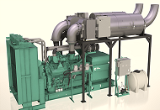

Green Solution
Sustainability….
Tier 2
Tier4i
83% Emissions reduction from Tier2 to Tier4i
Emissions from 1 Tier4i = 6 Tier2

Slide 21
Tier 4 Technology

Slide 22
How SCR Works
Exhaust
Tailpipe
Selective Catalytic Reduction
DEF is injected ahead of the catalyst. This converts to ammonia in the exhaust stream above 392ºF (200ºC).
The ammonia reacts with Oxides of Nitrogen (NOx) over the SCR catalyst to form harmless nitrogen & water.
Urea is injected at a ratio of typically 5% to diesel fuel use, depending on duty cycle. Urea tank sizes vary, but must be refilled to ensure emissions compliance.
DEF Injector
SCR Catalyst
(Maintenance Free)
Dosing Unit
(pump, metering, filter)
DEF Tank
DEF
Tank Heater

Slide 23
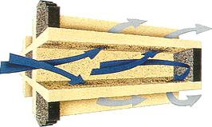
How the Diesel Particulate Filter (DPF) Works
Exhaust
Tailpipe
Diesel Particulate Filter
Ceramic wall flow filter captures
up to 95% of the carbon soot (PM) carried by the NO₂. This collects
on the filter to form Carbon Dioxide (CO₂ ) which leaves the tailpipe
as clean gas
Active Regeneration
Build up of incombustible ash will eventually require filter service cleaning, though only required at very long intervals
When soot accumulation in the DPF exceeds soot oxidation a periodic active regeneration mode is performed to prevent filter plugging. This is actuated by small quantities of fuel from a dosing injector or HPCR injection pulse during exhaust blow down. The heat released (no flame or burning) at 1022ºF( 550ºC) ensures sufficient oxidation to remove soot
Filter Service

Slide 24
CPG T4i: Aftertreatment Architecture
Tier 4i (Base Architecture) L176
  SCR Catalyst for NOx control
  Optional Exhaust Heater
SCR
Optional Heater
(Load Bank)
Mixer
Tier4 Final Certified L178
  SCR Catalyst for NOx control
  DPF for PM control
  Mandatory Exhaust Heater
DPF
SCR
Exhaust Heater
(Load Bank)
Mixer

Slide 25
Tier 4i (Base Architecture) Schematic
Air Filter
DEF Injection
Turbo
Mixing
SCR
Catalyst
NOx Sensing
Pressure sensing
Exhaust
Turbo After Cooler
Cummins Diesel Engine
Temp sensing
Generator
Control Panel
NOx Sensing
DEF Pump
DEF
Level sensing
Diesel Exhaust Fluid Tank
Notes:
25

Slide 26
Tier 4 Final Certified Schematic
Air Filter
DEF Injection
Turbo
Electric
Heater
Mixing
DPF
SCR
Catalyst
NOx Sensing
Pressure sensing
Exhaust
Heater Control
Turbo After Cooler
Cummins Diesel Engine
Generator
Temp sensing
Control Panel
NOx Sensing
DEF Pump
DEF
Level sensing
Diesel Exhaust Fluid Tank
Notes:
26

Slide 27
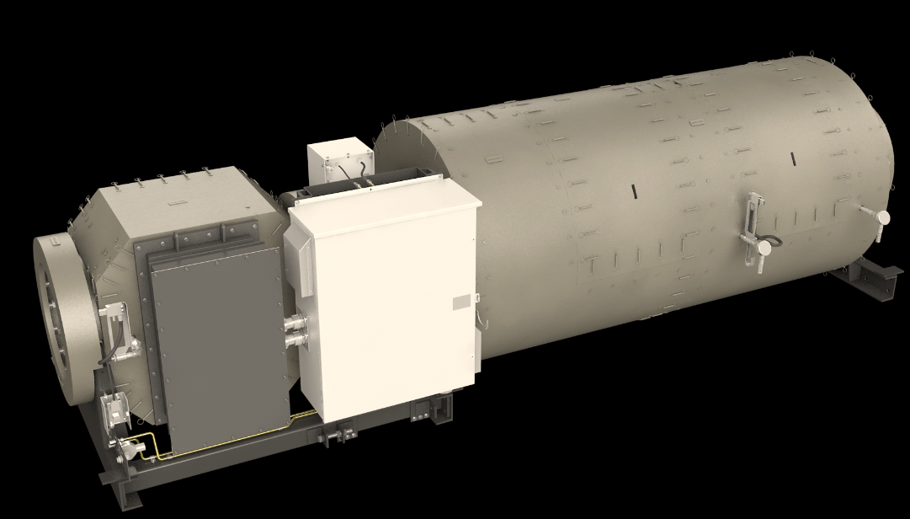
CPG T4F AT: CAS451
DEF Doser Assembly
DPF Section
SCR Section
Heater
Heater Control box

Slide 28
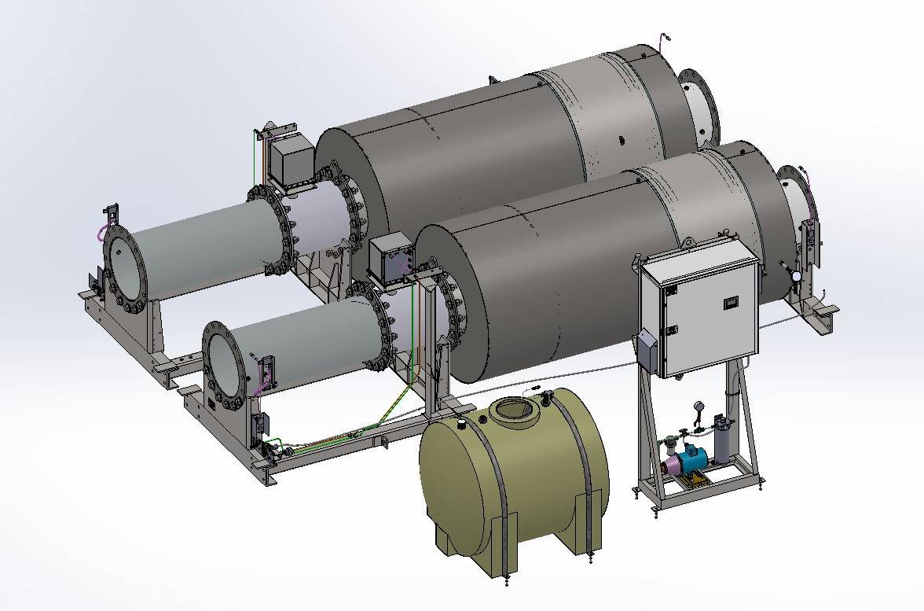
CPG T4i AT: CAS452 Base System
DEF Doser Assembly
SCR Section
AT Control Panel
DEF Tank
DEF Pump

Slide 29
CPG T4f AT: “2x45” Base + Loadbank + DPF
Support Frames

Slide 30
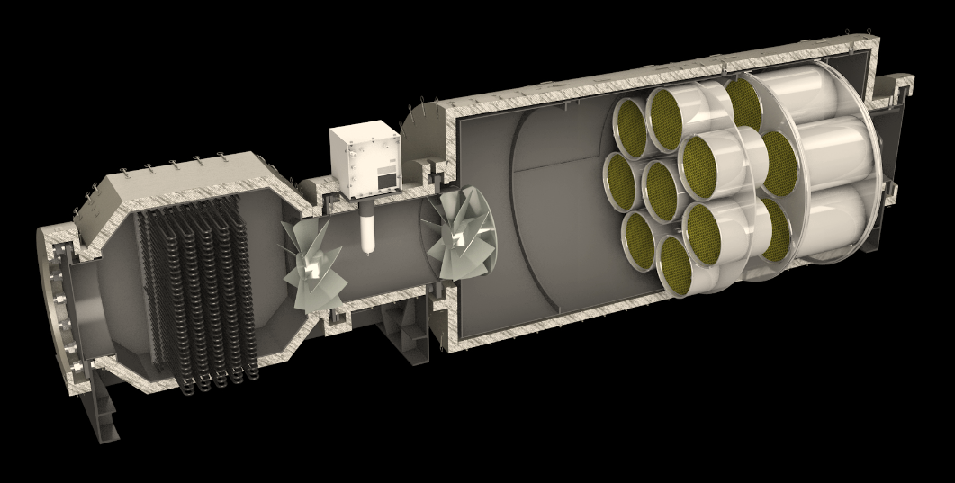
Sectional View of T4F Certified CAS451

Slide 31
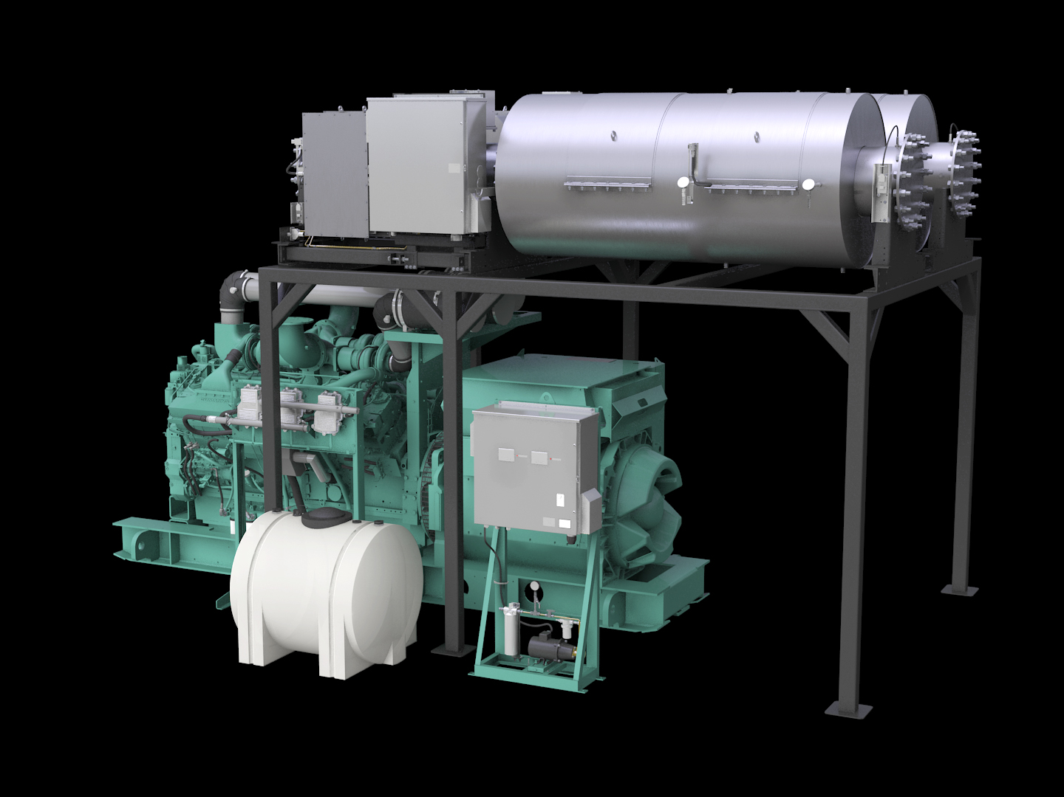
Tier 4F Certified Configuration CAS452

Slide 32
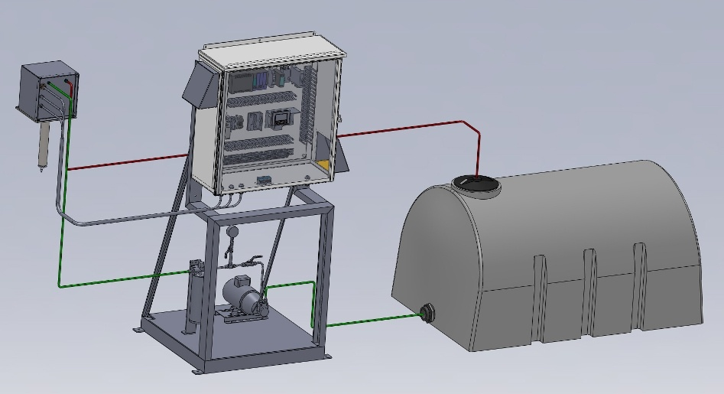
Dosing System
Airless Design
Single motor/pump (1 or 2 duct config)
Recirculation used for cold day freeze prevention.
Recirculation used in jacket cooler to keep injector from overheating. Continues to re-circulate DEF after shutdown to prevent heat soak back related failures.

Slide 33

CPG T4i/f AT: Dosing System Flow Diagram
5 Micron
Filter
Solenoid
Shutoff
Position
Encoder
DEF Supply
50/200 PSI
26 gph
P
20%
Pressure
Transmitter
Injector
80%
Injector Cooler
Optional Inline Heater
(Cold Weather Package)
DEF Return
5-10 PSI
22 gph
Flow Orifice
Operating modes:
  Recirculation mode: 50 psi pressure set point
    DEF is re-circulated to maintain temperature
      Injector cooling
      Freeze protection
  Dosing mode: 200 psi pressure set point
    Re-circulation flow continues to keep injector cool
    Injector position determines flow rate of DEF to facilitate NOx reduction

Slide 34
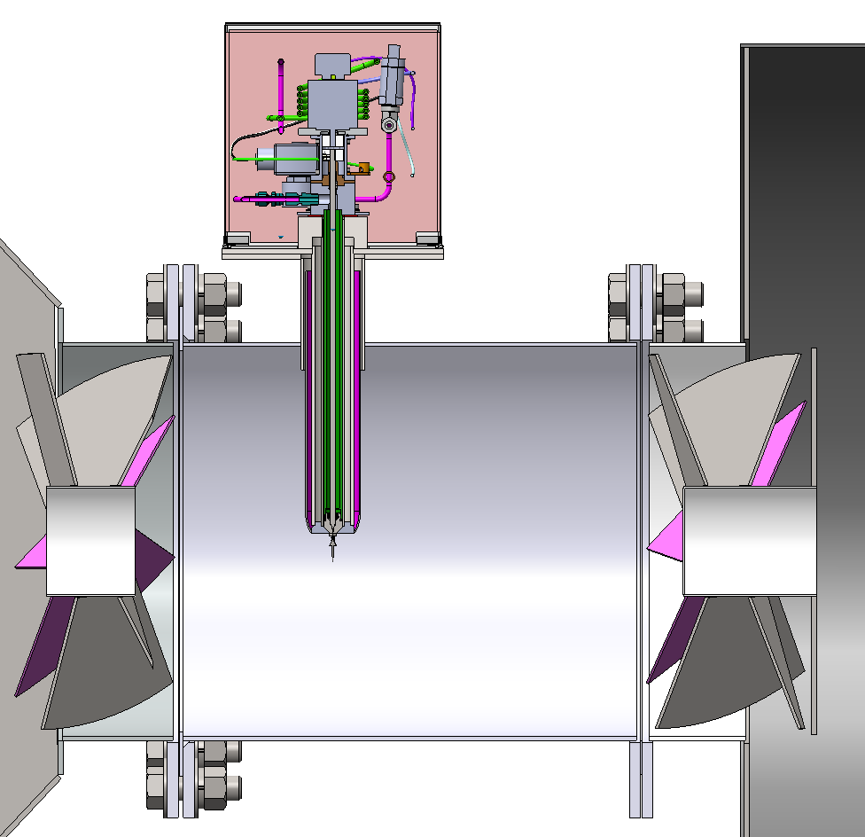
Mixing Section
Decomposition Reactor Tube (DRT)
Diesel Exhaust Fluid (DEF)
Injector
Static Mixers

Slide 35
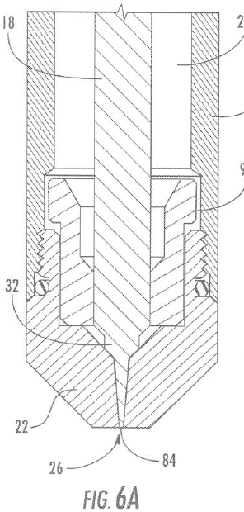
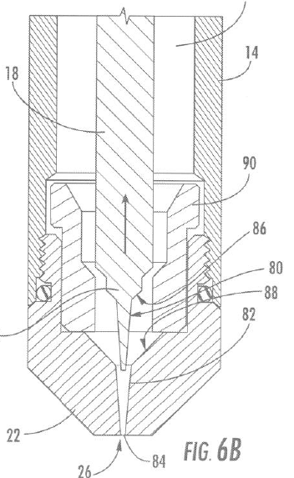
Injector & Cooling Jacket Design
Self Cleaning
Stepper Motor Drive
Turn down ratio of 10:1
Constant 200 psi for dosing
  50 psi recirculation mode after shutdown
Easy to Service
Patent pending injection system with high precision control!

Slide 36

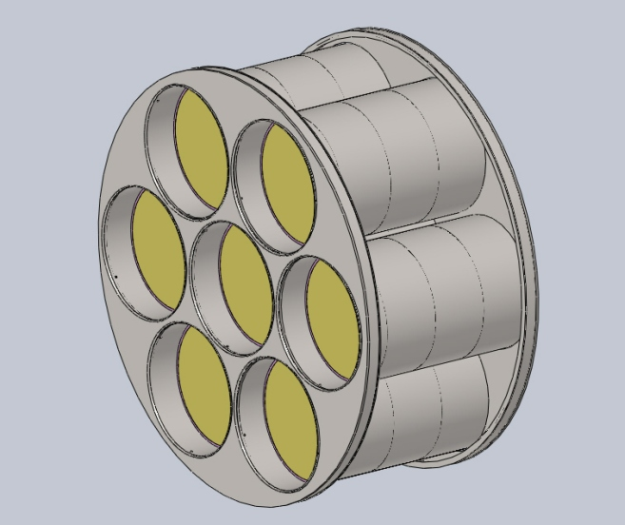
SCR Catalyst
Selective Catalytic Reduction (SCR) Catalyst details
  Vanadia based catalyst
  13" diameter x 6" length
  300 cpsi cell density
  Used on ISM11 / ISZ13 automotive applications
3 catalyst elements per sleeve in the cartridge
No routine maintenance expected for SCR catalyst

Slide 37
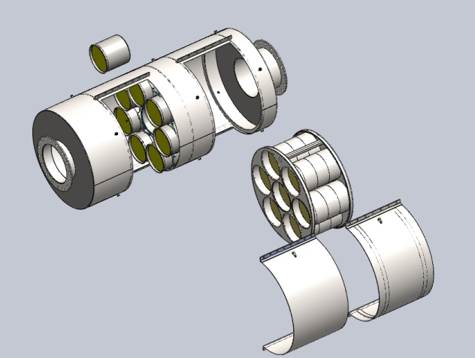
Diesel Particulate Filter Details
  Used on ISX automotive application
  DPF canisters individually serviceable
  Utilizes existing Cummins cleaning machines.
Large DPF surface area minimizes exhaust restrictions!

Slide 38
Optional Kits
DEF Freeze protection kit.
  Required for ambient conditions of 20DegF or below
  2kw Heater, Needs 120V AC
  Inline heater
  Designed to protect DEF down to -30DegF
DEF Supply and return lines
  40ft supply and return
  Stainless Steel

Slide 39
Other Considerations
120VAC Power is required when genset is stopped
  AC Power to drive DEF pump for recirculation
  DEF Freeze protection kit.
Customer must supply ducting in and out of AT. Engine to AT ducting should be insulated.
Customer must supply DEF piping from SCR Control Panel to AT and return to tank.

Slide 40
Service/Maintenance

Slide 41
Service Considerations
Scheduled Maintenance Items
  DEF Filters (35 micron, 5 micron, interval 500 hrs)
    Interval will be aligned with existing genset schedule
  DPF ash cleanout (interval >4000 hours)
  Breather filter elements (target 1000 hrs)
Consumable Items
  Diesel Exhaust Fluid (DEF)
  ULSD fuel required (<15PPM)

Slide 42
Key Points Certified Tier4i
Only Cummins & CAT has a EPA certified Tier4i Genset
CAT 800kw node uses On Engine solution, No Aftertreatment.
CAT does not have a Tier4i product from 800kw – 1650kw
Cummins has product across the range.
Only Cummins has a BOTH Tier4i and Tier4 Final certified product.

Slide 43
EPA Tier4F Competitive Genset Comparison
Attribute | ECO Tier 4F | MTU | CAT
Engine | QST30, QSK50, QSK60, QSK78 | Series 4000, V16, 12, 20
Power Node (kw) | 750-1000,1200-1500, 1750-2250, 2500-2750 | 600 - 3250kw
Availability | Now | Now
Certification | Tier4F Certified | T4F Verified/Capable
AT Solution | HTR/DPF/SCR | Combination of DPF/SCR as required.
DEF Dosers | Airless DEF injection, Self cleaning injectors | Airless DEF injection, also uses Trim Nox Technology. DEF Heater provided
NO
PRODUCT

Slide 44

Questions

